Slide 1
Secure Data Hiding in Image Using Steganography
CAPSTONE PROJECT
Presented By:
Student Name : Aditya Satyavan Bhagat
College Name & Department : Shri Balasaheb Mane Shikshan Prasarak Mandal’s, Ashokrao Mane Group of Institution - CSE

Slide 2
OUTLINE
Problem Statement
Technology used
Wow factor
End users
Result
Conclusion
Git-hub Link
Future scope

Slide 3
Problem Statement
Data security is a major concern in the digital world, as unauthorized access can lead to privacy breaches.
Traditional encryption methods make data secure but also attract attention from hackers.
There is a need for a covert method to securely transfer sensitive information without raising suspicion.
Steganography offers a way to hide confidential data within images, making it nearly undetectable.

Slide 4
Technology used
Programming Language: Python
Libraries:
1] cv2 (OpenCV) – for image processing
2] os – for handling file operations
3] string – for text processing
Concepts:
Least Significant Bit (LSB) encoding – stores message characters inside pixel values
Passcode-based authentication – ensures only authorized users can decrypt the message

Slide 5
Wow factors
Passcode Protection: Only authorized users can retrieve hidden data.
Real Image Encryption: The message is directly hidden inside pixel values instead of metadata.
Minimal Image Distortion: No significant visual changes to the image after hiding data.
Easy Accessibility: The script runs on any system with Python and OpenCV installed.

Slide 6
End users
Government & Defense Organizations: Secure communication and data transmission.
Journalists & Whistleblowers: Hiding confidential information from surveillance.
Cybersecurity Experts: Enhancing data security in networks.
General Users: Protecting private messages and personal data.

Slide 7
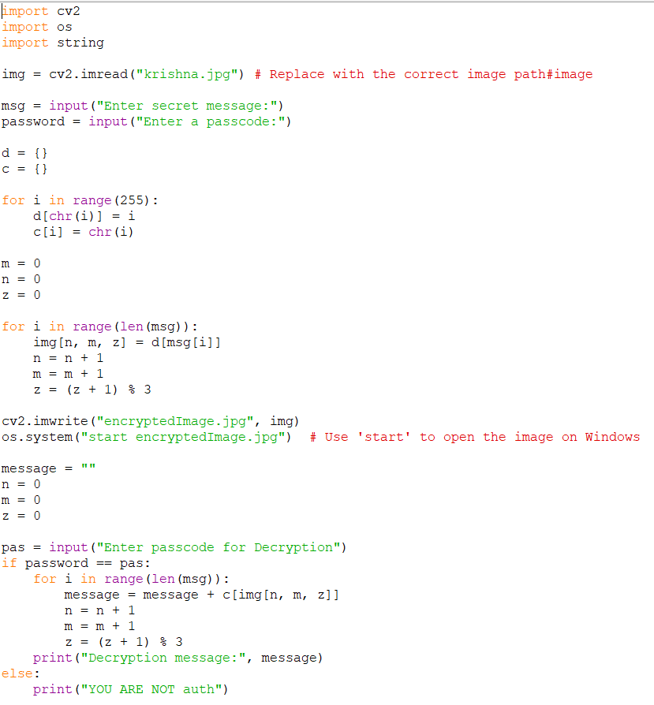
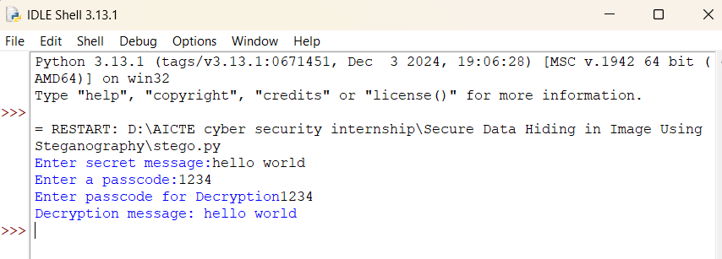
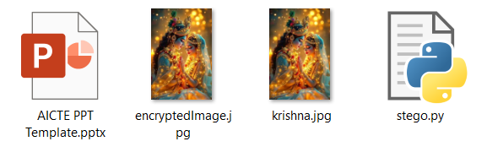
Results
Screenshots of the outcome (min 3)

Slide 8
Conclusion
The Python-based LSB steganography method ensures secure data hiding inside images.
The use of passcode authentication makes it harder for unauthorized access.
This method provides an effective, lightweight solution for covert data transmission.

Slide 9
GitHub Link
Make sure that there should be readme file

Slide 10
Future scope(optional)
Enhancing Security: Adding advanced encryption (AES, RSA) before embedding the message.
Increasing Capacity: Optimizing image storage to hide larger text or files.
User-Friendly Interface: Building a GUI-based tool or mobile app for easy use.
Multi-Layered Steganography: Hiding data across multiple images for enhanced security.

Slide 11
THANK YOU

